Slide 1

Analysing the customer behaviour for ABC Company Ltd.
Identifying target for new product launch
Analysis by XYZ | 31st March, 2024

Slide 2
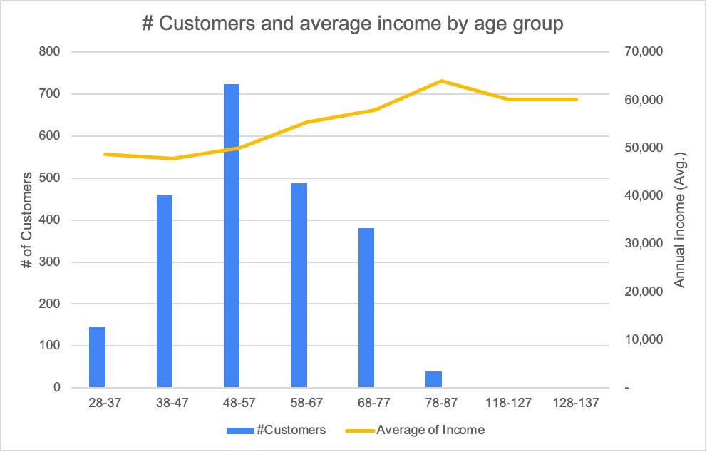
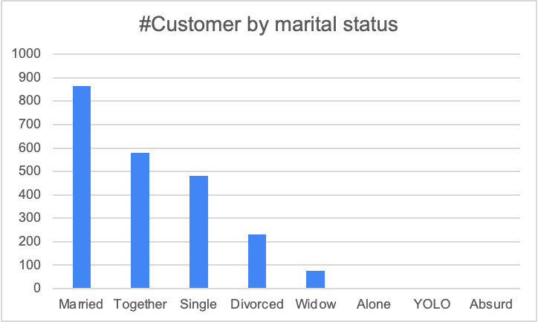
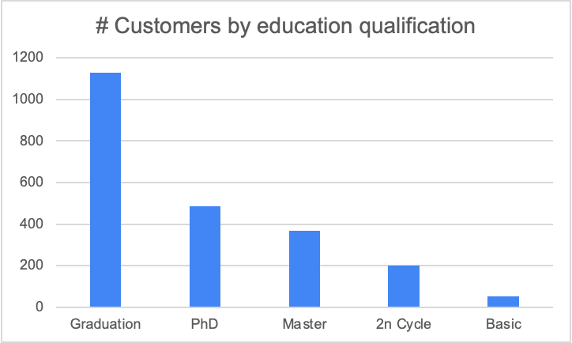
Understanding the distribution of customers currently
Distribution of customers and income by age, marital status and education
Key Observations
Most of the customers are middle aged ranging from 35 to 60 years, shows potential of targeting this group often
Married people are the highest customers, this might be because of high number of kids
Graduated people are ideal customers maybe because of higher income and more kids
Average income and # customers by age group
48-57 age, married and graduated people majorly become customers of ABC company Ltd.
Data from 2012 to 2014 | Data source: ABC Company Ltd. | Verified customers of ABC included in the analysis

Slide 3
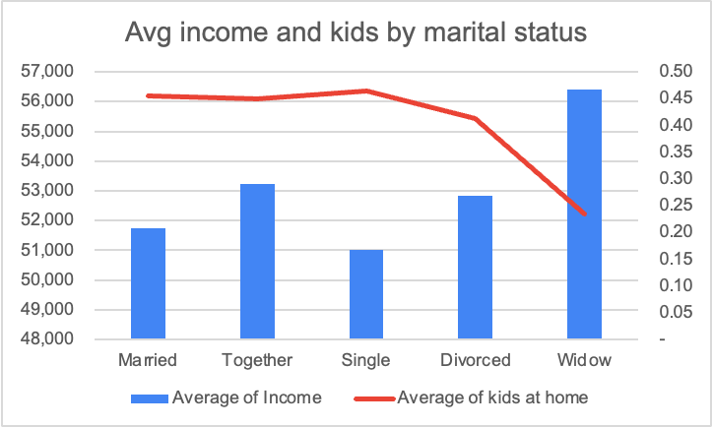
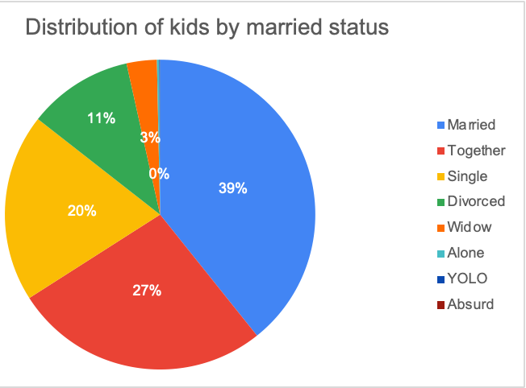
We will evaluate reason why customer becomes a customer
We will explore if income and count of kids impact on married behaviour
Key Observations
Married people have higher kids at home which means kids at home result in customer conversion
Higher distribution (40%) of kids for married couple means kids drive purchases for these customers
Average kids at home and income by marital status
High distribution of kids for married people
Average number of kids have impact on customers, average income doesn’t impact customer
Data from 2012 to 2014 | Data source: ABC Company Ltd. | Verified customers of ABC included in the analysis

Slide 4
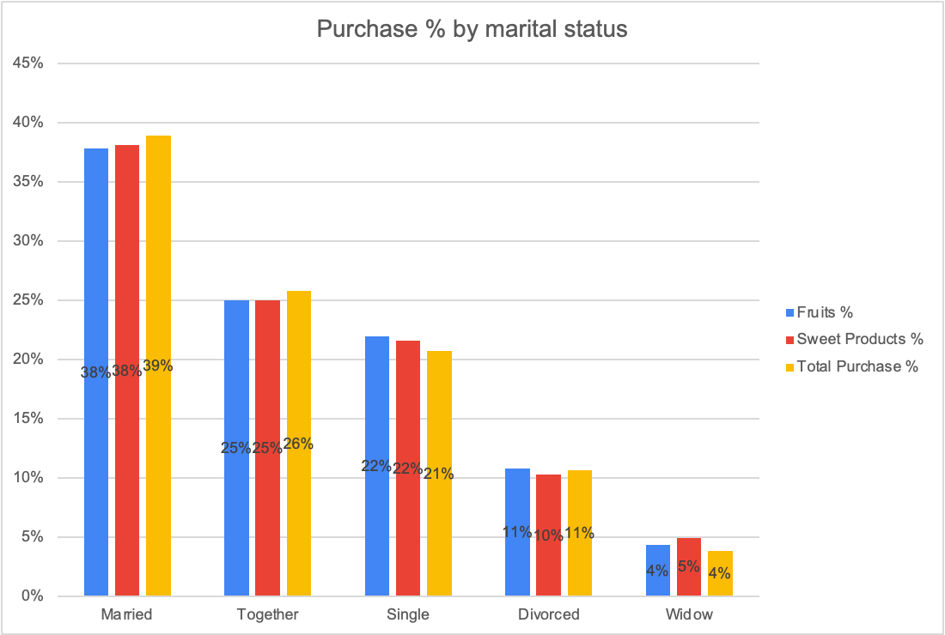
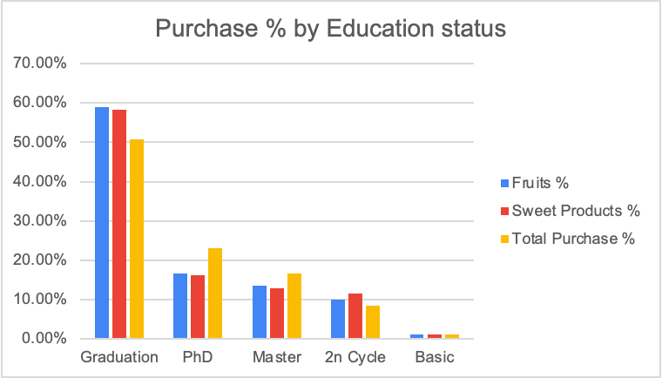
We will evaluate if high customer result in high purchase
Married and graduate were highest customer segment, assessing purchases here
Key Observations
Married people are the highest customer count and also result in highest purchase (±40%)
Similar to married people, graduates also were highest customer count and result in high purchases
Distribution of purchases by marital status
Distribution of purchase by education
High customer count also result in higher purchase, which means customer count is correlated with purchase
Data from 2012 to 2014 | Data source: ABC Company Ltd. | Verified customers of ABC included in the analysis

Slide 5
New Product Launch
Identifying best target customer group
Details in next slide

Slide 6
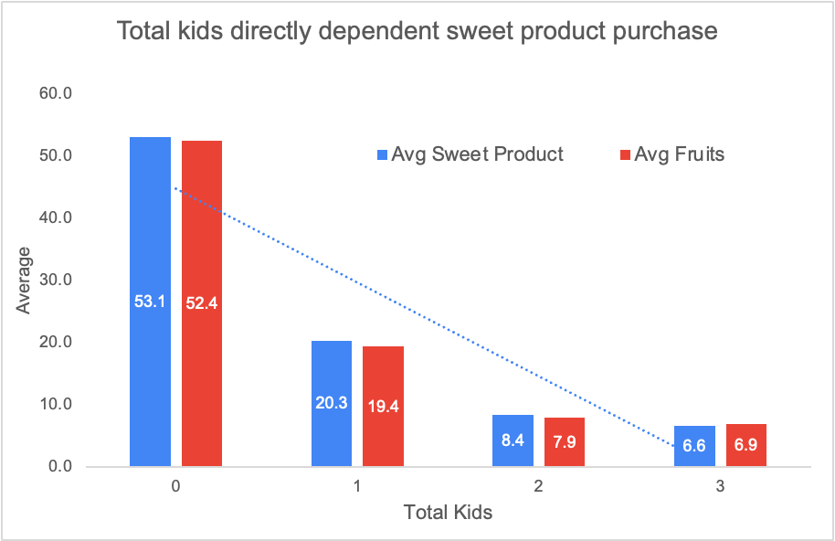
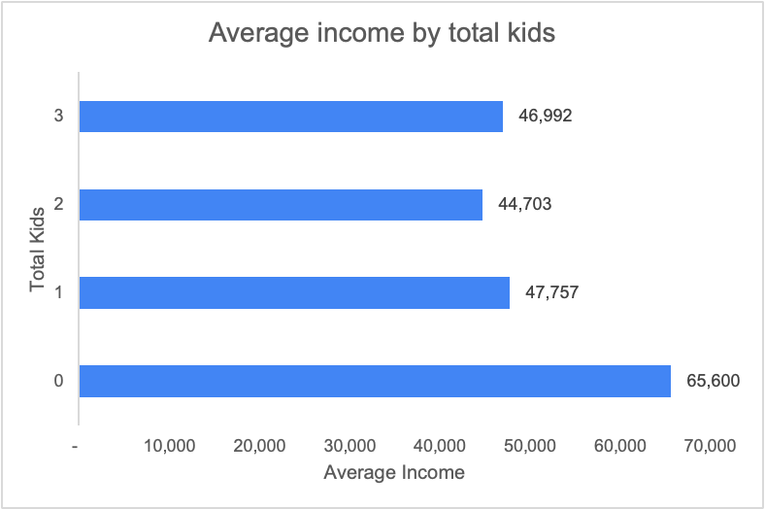
Analysing best customer segment for new sweet product
Kids at home and annual income are correlated and result in higher sweet purchas
Key Observations
We analyzed multiple factors to identify relationship between sweet products and sales
Eventually, we identified that sales of both sweet products and fruit products are dependent on total kids
Average income is also a factor of total kids
0 kids at home result in highest average sweet product purchase
Lesser kids at home means higher average income
For new product launch, we should target people with 0 total kids and also groups with higher income
Data from 2012 to 2014 | Data source: ABC Company Ltd. | Verified customers of ABC included in the analysis

Slide 7
Summary
Based on our observations, we can conclude the following for ABC Company Ltd. -
People with graduation as their education status are more prone to become customers
Married customers with kids should also be an area of focus for the company
Average number of kids impact customer behaviour positively
Average income does not impact the customer conversion
Number of customers are directly related to the purchases made
For new product launch, we should prioritise targeting people with “0” kids at home and people with higher average income

Slide 8
Communication Template

Slide 9
Introduction to the business problem and objective
Additional details of the problem (if any)
Analysis Owner | Date

Slide 10
High-level summary of the problem and findings
What was the problem
How did we approach the problem
What are the high level findings about the problem
Recommendations - Next Steps

Slide 11
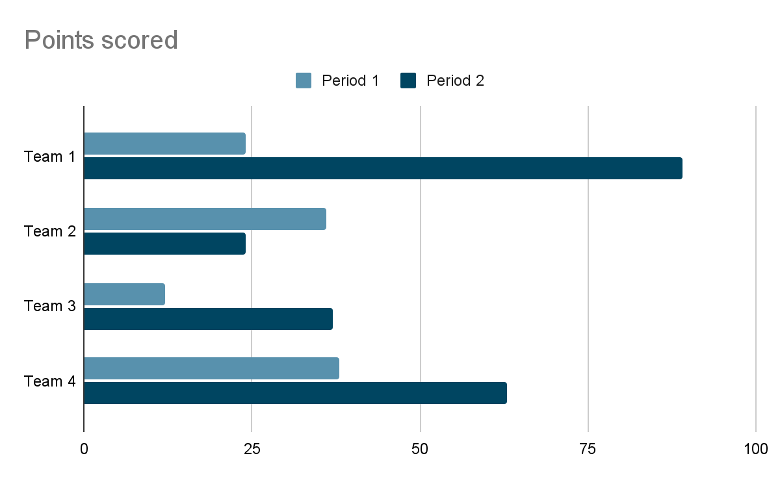
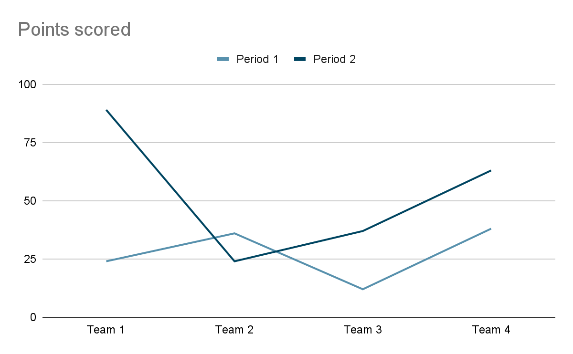
Talking Header to talk about the business objective / findings
Sub- Header provides additional details about the objective, solution
Insights Header (eg. “Key Observations”)
Insights Header
Important Insights 1
Insights 2
Insights 3
Insights 4
Key points to consider
Key mappings
Other trends
etc.
Callouts to highlight important chart elements
<< Mean
Details about the chart above
Details about the chart above
Takeaway Box concludes the entire slide with actionable insights and recommendations
Key highlight about data | Data time | Data source | Data caveats | …
Key information about the analysis | Mappings | Assumptions | etc..

Slide 12
APPENDIX
Additional Slides

